Slide 1
Chapter 19: Diode Applications (Part 3)
Voltage Regulators
Copyright © 2010 Christopher Teoh, Tan HJ & Wong WY Singapore Polytechnic. All rights reserved.

Slide 2
Objectives
After completing Part 3 of this chapter, you will be able to:
Understand the block diagram of a basic power supply
Determine line regulation and load regulation
Understand the function of a linear IC voltage regulator and differentiate between positive and negative voltage regulators.

Slide 3
19-4 Voltage Regulation
Basic DC Power Supply
A power supply is an essential part of each electronic system from the simplest to the most complex.
The dc supply converts the standard 230V, 50Hz ac available at wall outlets into a constant dc voltage
This is used to power all types of electronic circuits such as:
Television receivers
Stereo systems
VCRs
CD players
Lab equipment

Slide 4
Basic DC Power Supply
Transformer - steps down the ac voltage at the primary
Rectifiers - convert ac voltage into dc voltage
Filter – eliminates the fluctuations in the rectified voltage and produces a relatively smooth dc voltage
Voltage regulator - maintains a constant dc voltage for variations in the input line voltage or in the load
Load – a circuit for which the power supply is producing the dc voltage and load current

Slide 5
230V, 50Hz
Step-downed
Voltage
Rectified
Voltage
Filtered
Voltage
Step-down
Transformer
Rectifier
Filter
Voltage
Regulator
AC input
Load
Block Diagram of a
DC Power Supply
Regulated Voltage

Slide 6
Voltage Regulation
The main function of a voltage regulator is to maintain constant output voltage when
(a) its input voltage changes
(b) the load connected to it changes
Two basic categories of voltage regulation are
Line regulation
Load regulation
Line regulation maintains a nearly constant output voltage when the input voltage varies.
Load regulation maintains a nearly constant output voltage when the load varies

Slide 7
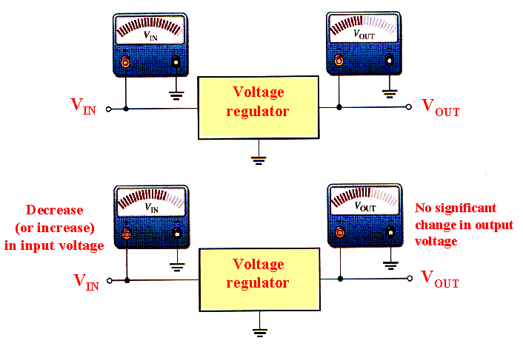
Line Regulation

Slide 8
Line Regulation
When the dc input (line) changes, voltage regulator must maintain a nearly constant output voltage.
This is defined as the percentage change in the output voltage for a given change in the input (line) voltage

Slide 9
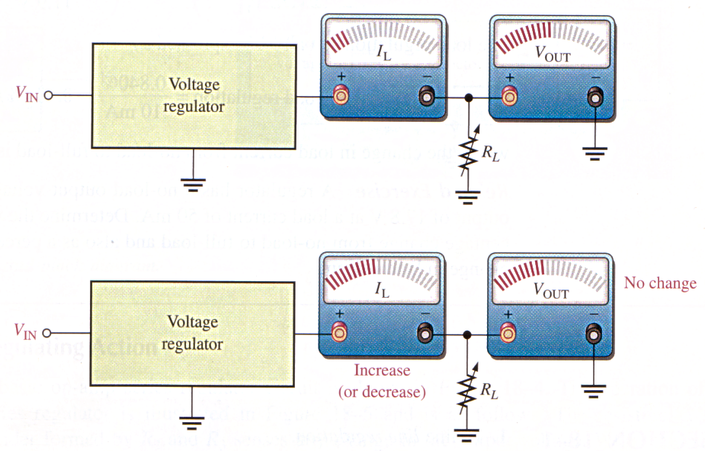
Load Regulation
When the amount of current through a load changes due to a varying load resistance, the voltage regulator must maintain a nearly constant output voltage across the load.
This is defined as the percentage in output voltage for a given change in load current
Voltage regulator
V_{IN}
No change
Voltage regulator
V_{IN}
Increase
(or decrease)

Slide 10
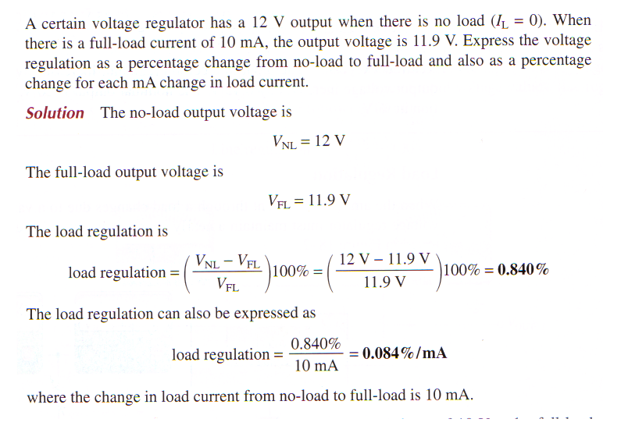
EXAMPLE 19-4

Slide 11
19-5 Integrated Circuit Voltage Regulator
Generally, the linear regulators are three-terminal devices that provide either positive or negative output voltages that can be either fixed or adjustable.
Fixed Positive Linear Voltage Regulators
Although many types of IC regulators are available, the 7800 series of IC regulators are representative of three-terminal devices that provide a fixed positive output voltage.

Slide 12
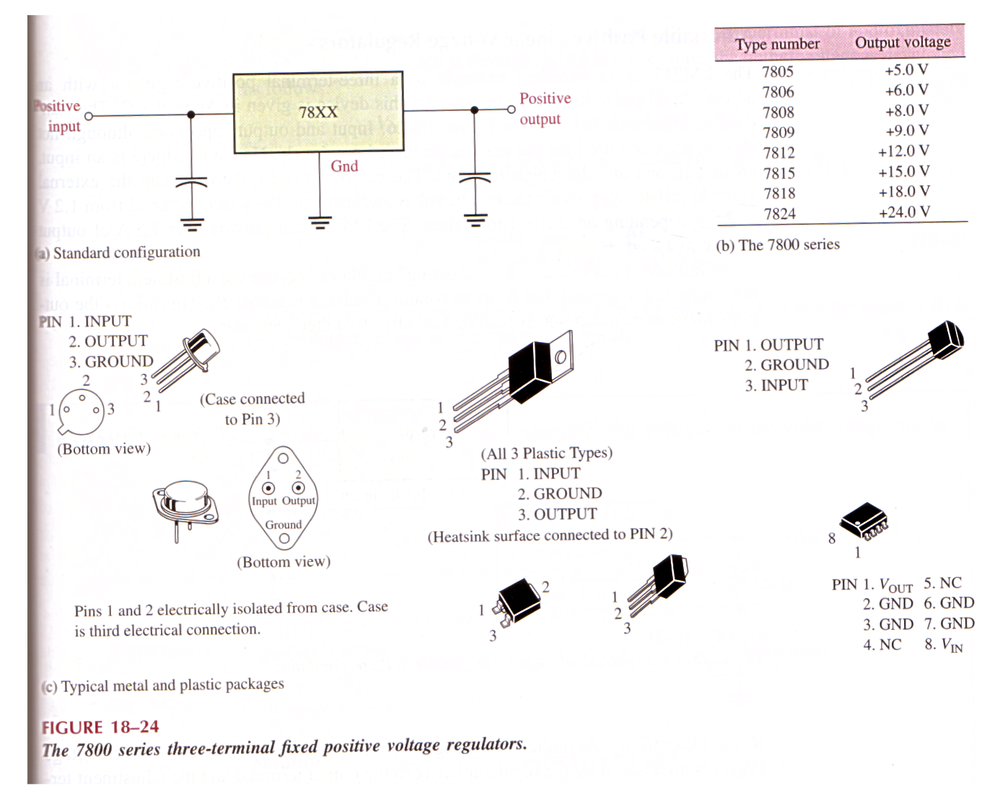
The three terminals are input, output, and ground.
The last two digits in the part number designate the output voltage.
Positive
input
Positive
output
The output capacitor acts basically as a line filter to improve transient response.
The input capacitor is used to prevent unwanted oscillations when the regulator is some distance from the power supply filter such that the line has high inductance

Slide 13
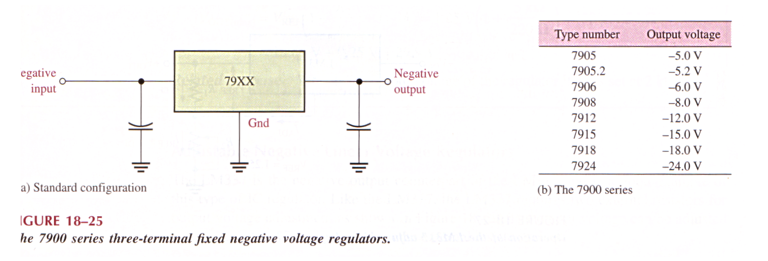
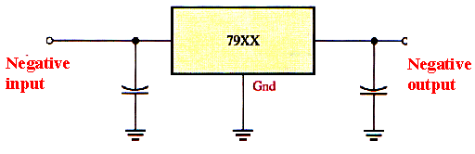
Fixed Negative Linear Voltage Regulators
The 7900 series is typical of three-terminal IC regulators that provide a fixed negative output voltage.
This series is the negative-voltage counterpart of the 7800 series and shares most of the same features and characteristics.

Slide 14
A dual-polarity power supply schematic.
_{230Vac}
Can you identify the various components in the power supply?

Slide 15
Summary
Voltage regulators maintain a constant dc output voltage as long as the input voltage or load varies within limits.
Three terminal linear IC regulators are available to provide either fixed-value or variable value output voltages of positive or negative polarities.
The 7800 and 7900 series regulators provide fixed-value positive and negative output voltages respectively.

Slide 16
End of Chapter 19 (Part 3)

